Slide 1
What is it?
Student: Do Dung Vu
Supervised by: Prof. Sylvie Ratté and PhD. Ronald Brisebois

Slide 2
Outline
Motivation
Artificial intelligence (AI) forecast
AI virtual assistance
Literature review
Challenges
Objectives
Methodology
Study Plan
Question

Slide 3
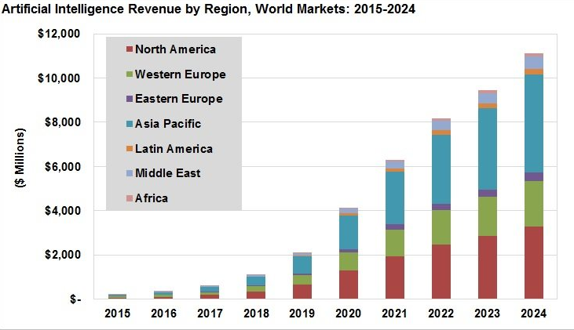
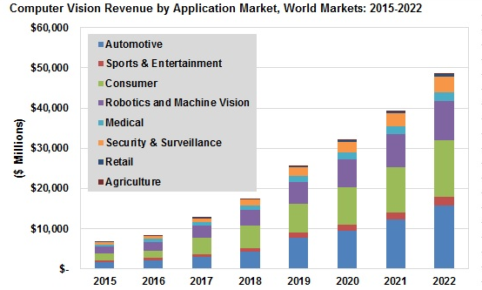
Artificial intelligence (AI) forecast
Source: Tractica

Slide 4

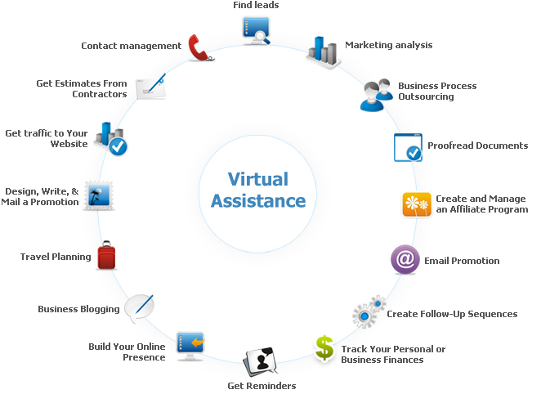

AI virtual assistants
- Could you explain and show me more information of the new items which I have not seen yet?
Source: http://www.cogniview.com

Slide 5
Literature review

Slide 6
Challenges
Identify and recognize the object with the “private feature” of artwork, specimen
Faster handling of responding for real time used cases
Data authenticity, confidentiality, ready, and integrity for real time applications
Updating meta-data based on the collected information from each node ( user)

Slide 7
Objectives
Enhance privacy virtual assistance in Library and Museum
Improve the accuracy and performance of object recognizing to detect the “private feature” of each artwork and specimen in the museum
Design automatically category mechanism for object recognition, and application development as well as for detecting “private feature” of each artwork and specimen
Develop algorithms and applications based on the given metadata of the library, museum, or open data

Slide 8
Methodology
Exploit the Artificial, Deep, Recurrent, Convolutional neural networks (ANN,DNN, RNN,CNN), Supervised, Unsupervised, and Deep reinforcement learning, search engine algorithm to improve the quality of object recognition.
Build-up machine learning algorithms and artificial intelligence in order to recognize, analyze and make the explanation of a given object by using smartphone camera.
Make the approximated verification method to confirm the accuracy of generated information

Slide 9

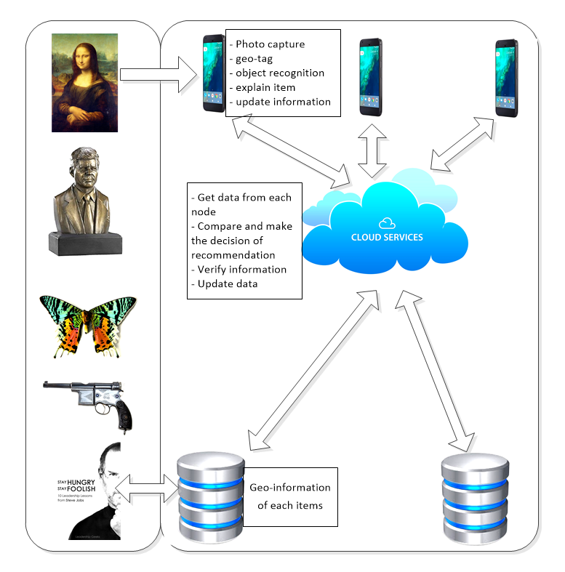
System model

Slide 10
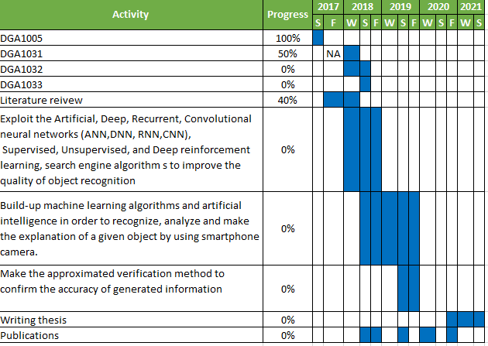
Study plan

